Slide 1

Employees Attrition Analysis
Decode the Why , Improve the Stay
Data-Driven Insights & Recommendations
By Vaishnavi Karle
16-11-2025

Slide 2
Problem Objective
Employee attrition is a major challenge for organizations because losing employees leads to high hiring costs, productivity loss and disruption in team performance.
This project aims to understand why employees are leaving the company and identify the key factors influencing their decision to resign.
By analyzing patterns in work-life balance, job satisfaction, appraisal rating, overtime and tenure. The project helps HR and leadership make informed decisions to reduce turnover, improve employee experience and strengthen the overall retention strategy.

Slide 3
Agenda
01
Problem objective
05
Dashboard
02
Data Overview
06
Recommendations
03
Methodology
07
Conclusion
04
Key Insights

Slide 4
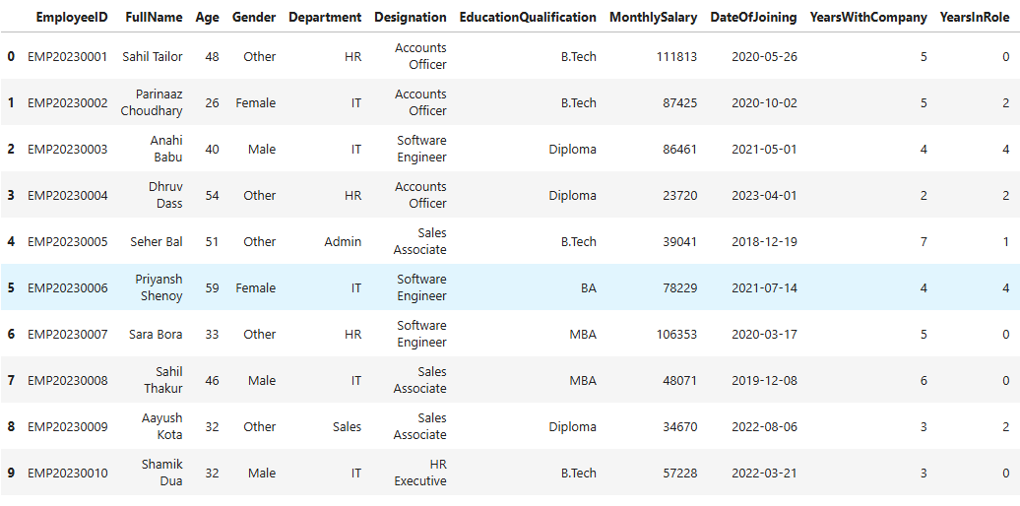
Data Overview
10 rows × 22 columns

Slide 5
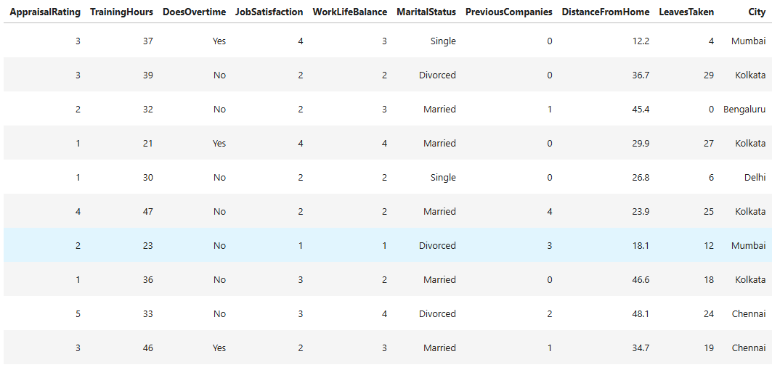
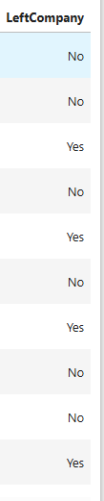

Slide 6
Methodology
Data Cleaning :
Handled mismatched values and removed irrelevant columns.
Converted Yes/No fields to 0/1 and standardized the dataset.
Data Transformation:
Perform Feature Binning for analysis.
Encoded categorical variables for analysis.
EDA(Exploratory Data Analysis):
Find out the factors influencing attrition.
Used charts and mean comparisons to analysis.
Correlation analysis:
Checked relationships between numerical features and attrition.
Identify the key drivers influencing the attrition.
Hypothesis Testing:
Tested whether attrition differences across groups are statistically meaningful.
Confirms these factors truly influence attrition , not random variations.

Slide 7
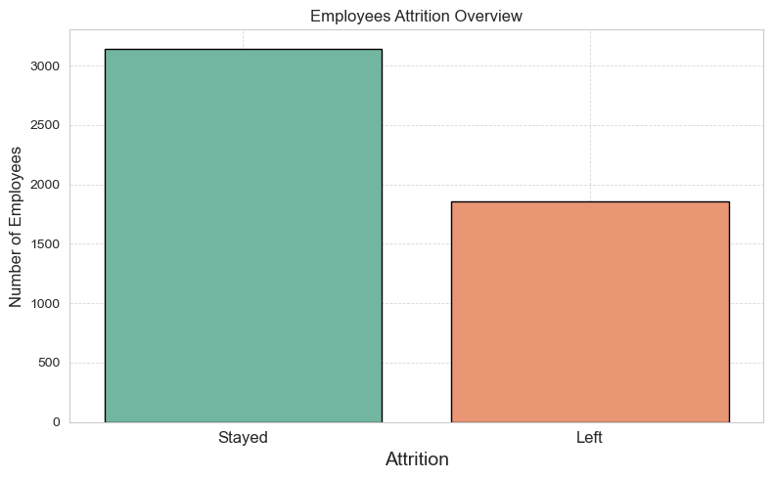
Key Insights
Employees Attrition Overview
This chart shows how many employees left the company. High attrition signals issues in satisfaction or work environment.
The number of employees who Left is 1855(37.1%) and the number of employees who Stayed is 3145(62.9%).

Slide 8
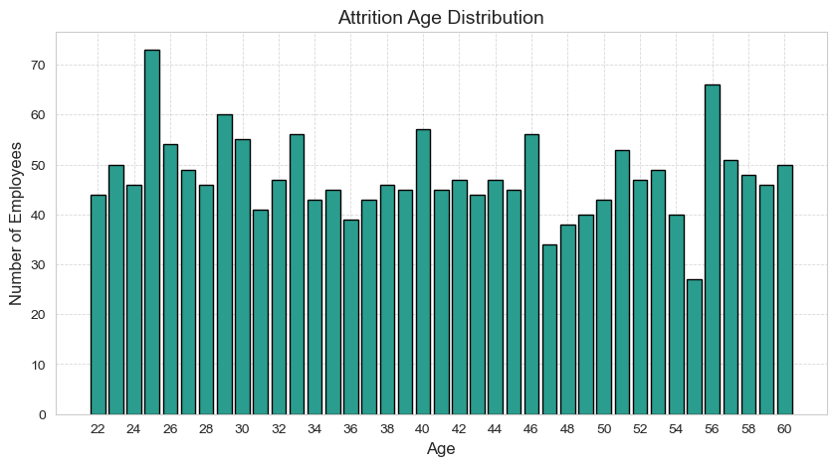
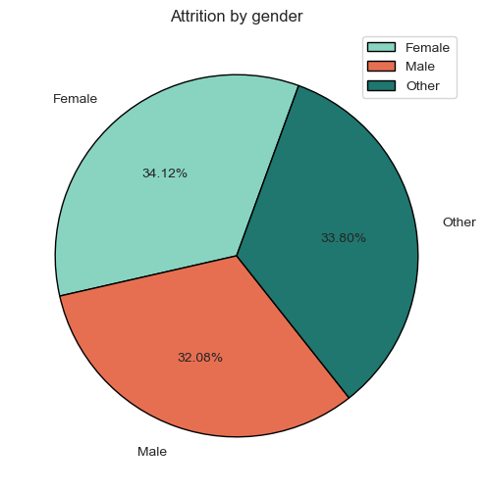
Age
Gender
Younger employees show higher attrition with age between
22 – 30 as they switch jobs more often.
Age has almost no direct impact on attrition.
Gender does not influence the attrition as the above pie chart showing stability between the genders.

Slide 9
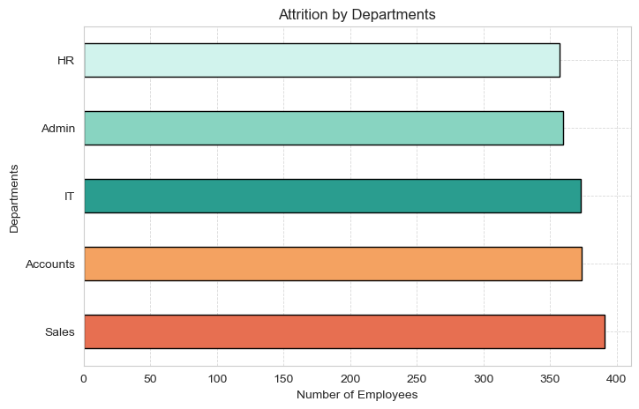
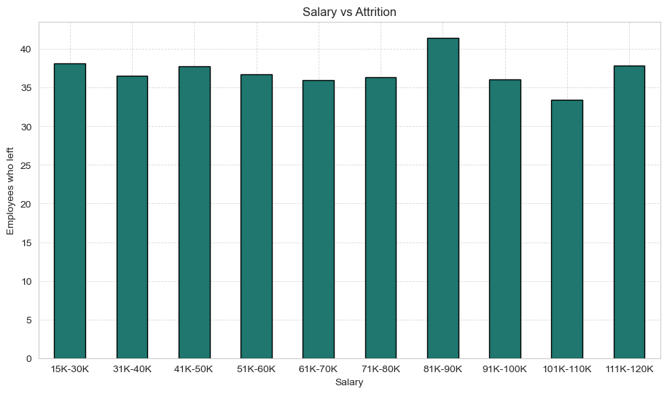
Departments
Salary
Sales department influence by the attrition more as compare to other departments.
But there is not direct strong relationship between departments and attrition.
Salary group 81K-90K showing the highest attrition but the attrition does not influence by salary directly.

Slide 10
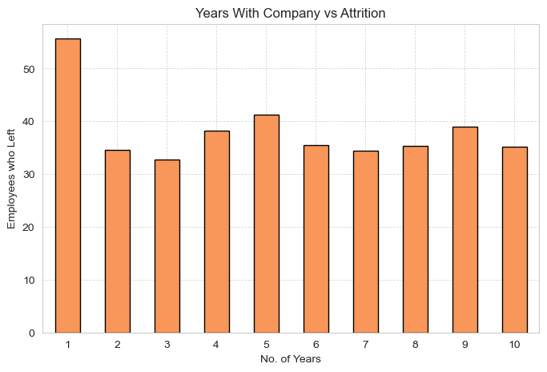
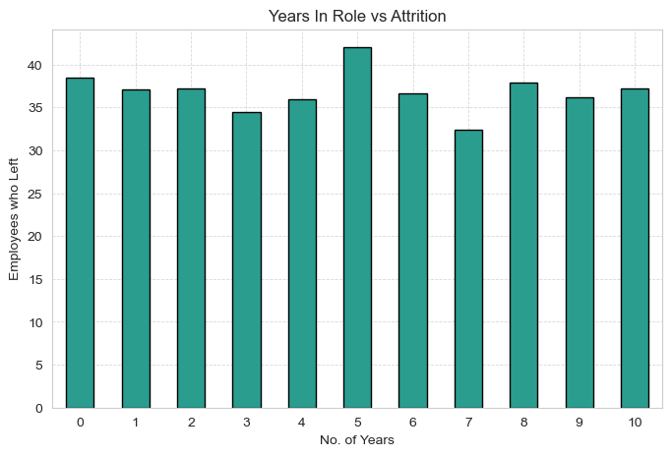
Year With Company
Years In Role
Employees with 1 year with the company left mostly.
This indicates an expectations reality mismatch in the early stages.
Above chart showing employees with 5 year in same roles intent to left the company most.
But there is no direct relationship between Years In Role and Attrition.
Year with company and Years in role are showing strong correlation but neither significantly affects attrition.

Slide 11
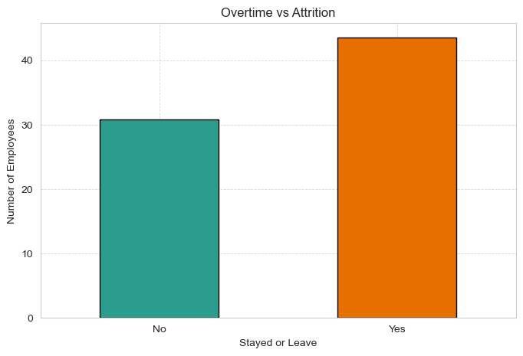
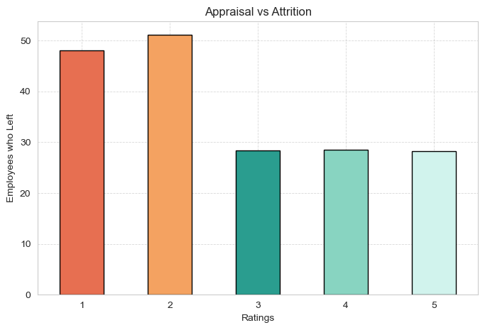
Over Time
Appraisal
This chart showing that employees who did overtime are more intent to leave the company.
The correlation between Overtime and Attrition having strong correlation with 0.13. This indicating Over Time is the factor that strongly influencing the Attrition.
Employees who rate 1 and 2 for appraisal are more likely to leave the company.
The correlation between Appraisal and Attrition showing Strong Negative relationship with -0.18 indicating poor appraisals are reason to increase attrition.

Slide 12
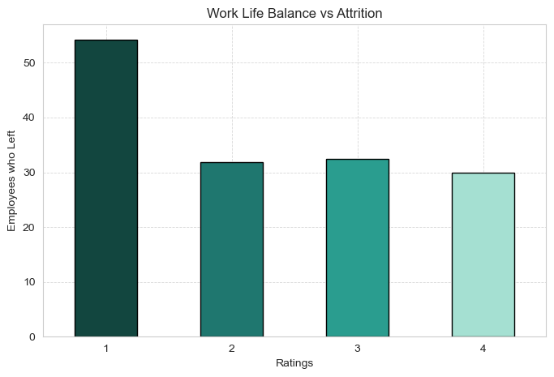
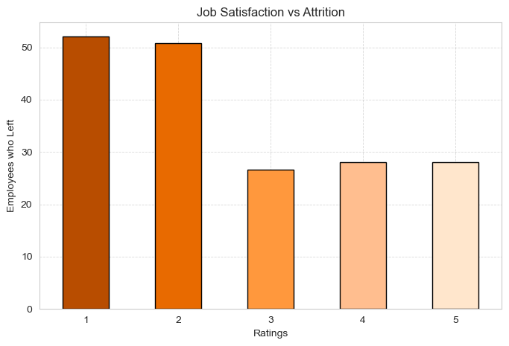
Work Life Balance
Job Satisfaction
Employees who rate 1 are more likely to leave the company.
The correlation between Work Life Balance and Attrition showing significant negative relationship with -0.17 indicating worse Work Life Balance influencing attrition
This chart showing that employees with 1 and 2 Job Satisfaction rating are more likely to leave the company.
The correlation between Job Satisfaction and Attrition showing the Strongest negative relationship with -0.21. This is the Strongest factor indicating low satisfactions is a key driver of attrition.

Slide 13
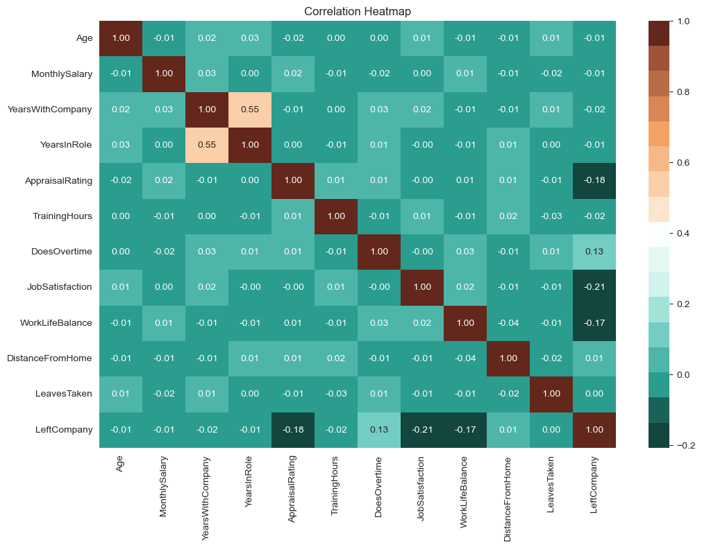

Slide 14
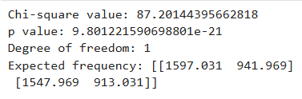

Hypothesis Testing
Hypothesis 1: Does Over time vs Attrition
Test: Chi-Square(Binary vs Binary)
Null hypothesis(H0):
Over time does not affect attrition
Alternative hypothesis(H1):
Over time does affect employees attrition
Since the p-value is extremely smaller than 0.05, we reject the null hypothesis.
Hypothesis 2: Job Satisfaction vs Attrition
Test: Mann Whitney U Test(Ordinal vs Binary)
Null hypothesis(H0):
Job satisfaction levels are for same for both who leaves and who stays
Alternative hypothesis(H1):
Employees with Lower Job Satisfaction are more likely to leave.
Since the p-value is far below 0.05, we reject the null hypothesis.

Slide 15


Hypothesis 3: Work life balance vs Attrition
Test: Mann Whiteney U test(Ordinal vs Binary)
Null hypothesis(H0):
Work life balance for both employees are same for all employees
Alternative hypothesis(H1):
Employees with lower work life balance have more chances to attrition
Since the p-value is far below 0.05, we reject the null
hypothesis.
Hypothesis 4: Appraisal Rating vs Attrition
Test: Mann Whiteney U test(Ordinal vs Binary)
Null hypothesis(H0):
Appraisal rating for both employees are same for all employees
Alternative hypothesis(H1):
Employees with lower appraisal have more chances to attrition
Since the p-value is far below 0.05, we reject the null
hypothesis.

Slide 16
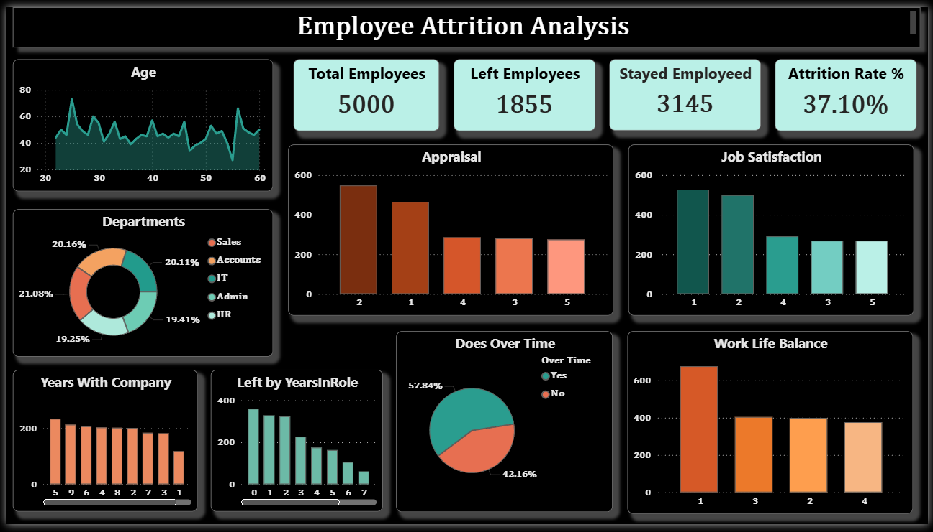

Slide 17
Recommendations
Reduce Overtime and Workload Pressure:
Review workloads in high-pressure departments like Sales and IT. Excessive overtime increase attrition, so balancing work distribution or hiring additional staff will improve retention.
Improve Work-Life Balance Programs:
Introduce flexible schedules, hybrid working or reduced overtime hours. Employees with poor work-life balance leave at much higher rates, so improving this can immediately reduce attrition and burnout.
Strengthen Early-Career Support for first (1-3 Years):
Provide structured onboarding, mentorship and growth opportunities during the first 3 years. This is the period with the highest attrition, so targeted support can significantly improve employee retention.
Enhance Job Satisfaction Through Engagement:
Conduct regular feedback sessions, maintain transparent communication and recognize employee contributions. Low Job Satisfaction strongly correlated with attrition, so significantly employees can reduce turnover.

Slide 18
Improve the Appraisal and Recognition System:
Ensure appraisals are fair, consistent and supportive. Employees with lower appraisal ratings tend to leave more, so offering constructive feedback and recognition can help retain them.
Focus Retention Efforts in High Attrition Departments
Implement targeted retention plans for departments like Sales and IT. These areas show the highest employee churn, indicating a need for better support, training and incentives.

Slide 19
Conclusion
The analysis reveals that attrition in the organization is primarily driven by factors related to job satisfaction, appraisal fairness, work-life balance, overtime pressure and early-career instability. While demographic variables such as age, salary and distance from home show very weak correlations with attrition.
Employees with low satisfaction, poor appraisals, overtime workloads and weak early-career support are significantly more likely to leave. Sales and IT departments face the highest attrition, suggesting a need for focused retention strategies.
Addressing these key areas through better work-life balance practices, stronger employee engagement, fair appraisal systems and department-specific support will help reduce the attrition rate and improve overall employee satisfaction and organization stability.

Slide 20
Thank You

